Slide 1
COFEE SALE ANALYSIS BY:BASUDEV PAL

Slide 2
Problem Statement
01
How do sales vary by day of the week and hours of the day ?
02
Are there any peak times for sales activity?
03
What is the total sale revenue for each months?
04
How do sales vary across different store location?
05
What is the average price/order per person ?

Slide 3
Project Overview
In this project, I used Excel to analyze coffee shop sales data, focusing on data cleaning with Power Query, data modeling with Power Pivot, and visualizing insights with charts. The key questions addressed are:
1-How do sales vary by day of the week and hours of the day?
2-Are there any peak times for sales activity?
3-What is the total sales revenue for each month?
4-How do sales vary across different store locations?
5-What is the average price/order per person?

Slide 4
INSIGHTS:
1-How do sales vary by day of the week and hours of the day?
:-On Tuesday, the highest quantity of orders is placed, and between 9 AM and 10 AM, the highest number of orders is placed.
2-Are there any peak times for sales activity?
:-Yes, there are peak times for sales activity. The highest number of transactions occurs between 9 AM and 10 AM, indicating this period as the peak time for sales activity.
3-What is the total sales revenue for each month?
:-January: $81,677.74
February: $76,145.19
March: $98,834.68
April: $118,914.08
May: $156,727.76
June: $166,485.88
Among these, June generated the highest revenue, while January recorded the lowest revenue.
4-How do sales vary across different store locations?
:-Sales vary significantly across different store locations. Hell's Kitchen has generated the highest revenue, while Lower Manhattan has recorded the lowest revenue among all the locations.
5-What is the average price/order per person?
:-The average price/order per person is $4.69.

Slide 5
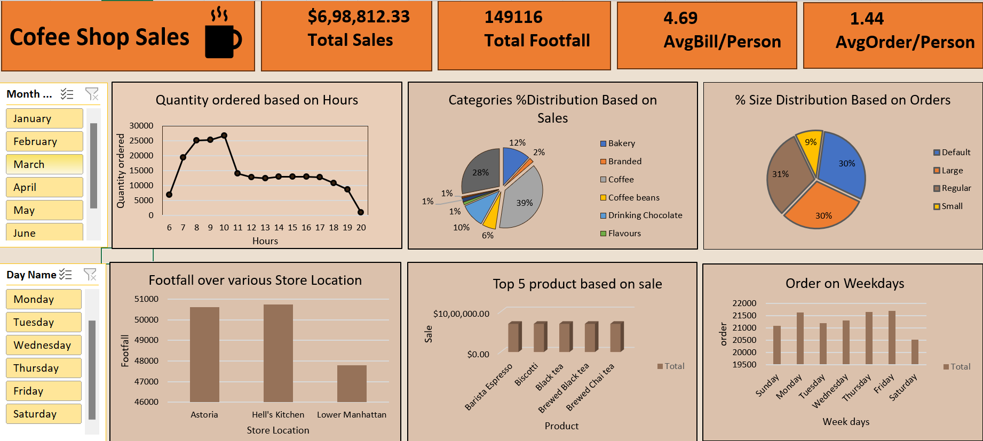
Visualization:

Slide 6
THANK YOU

